Slide 1
COMPUTER
NUMERICAL
CONTROL
CNC stands for computer numerical control. CNC routers can perform the tasks of many carpentry shop machines such as the panel saw, the spindle molder, and the boring machine. A CNC router is very similar in concept to a CNC milling machine.

Slide 2
Computer Numerical Control
Numerical control is a method of automatically operating a manufacturing machine based on a code of letters, numbers, and special characters.
The numerical data required to produce a part is provided to a machine in the form of a program, called part program or CNC program.
The program is translated into the appropriate electrical signals for input to motors that run the machine.

Slide 3
History of CNC
1949
US Air Force asks MIT to develop a "numerically controlled" machine.
1952
Prototype NC machine demonstrated (punched tape input)
1980-
CNC machines (computer used to link directly to controller)
1990-
DNC: external computer “drip feeds” control programmer to machine tool controller

Slide 4
Motivation and uses
To manufacture complex curved geometries in 2D or 3D was extremely expensive by mechanical means (which usually would require complex jigs to control the cutter motions)
Machining components with repeatable accuracy
Unmanned machining operations

Slide 5
Advantages of CNC
- Easier to program;
- Easy storage of existing programs;
- Easy to change a program
- Avoids human errors
- NC machines are safer to operate
- Complex geometry is produced as cheaply as simple ones
- Usually generates closer tolerances than manual machines

Slide 6
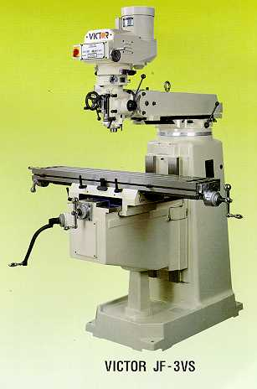
Conventional milling machines
Vertical milling machine

Slide 7
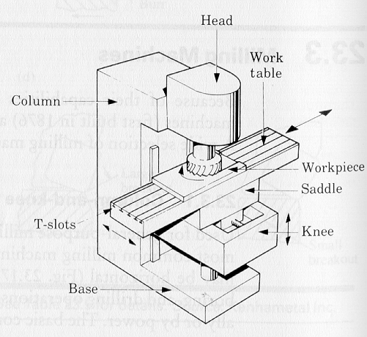
Conventional milling machines
Vertical Milling machine architecture

Slide 8
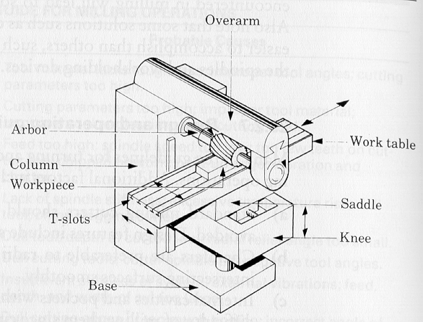
Conventional milling machines
Horizontal Milling machine architecture
How does the table move along X- Y- and Z- axes ?

Slide 9
NC machines
Motion control is done by: servo-controlled motors

Slide 10
CNC terminology
BLU: basic length unit ➔
smallest programmable move of each axis.
Controller: (Machine Control Unit, MCU) ➔
Electronic and computerized interface between operator and m/c
Controller components:
1. Data Processing Unit (DPU)
2. Control-Loops Unit (CLU)

Slide 11
Types of CNC machines
Based on Motion Type:
Point-to-Point or Continuous path
Based on Control Loops:
Open loop or Closed loop
Based on Power Supply:
Electric or Hydraulic or Pneumatic
Based on Positioning System
Incremental or Absolute

Slide 12
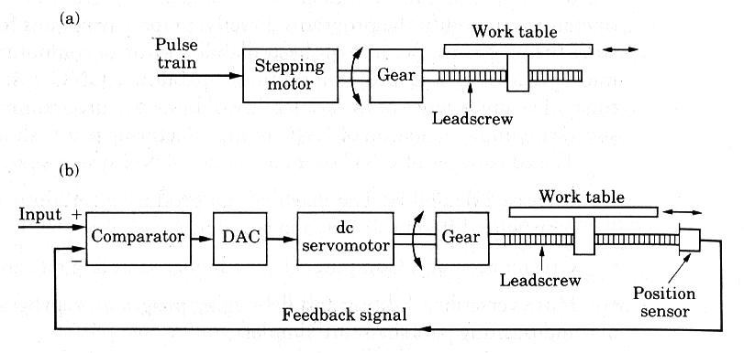
Open Loop vs. Closed Loop controls

Slide 13
PROGRAMMING FORMATS:
Format is the method of writing the words in a block of
instruction. Three program formats are used.
Fixed Block Format: Here the instructions are always
given in the same sequence. All instructions must be given
in every block, including those which remain unchanged
from the preceding block.
Tab Sequential Format: Here the instructions a block are
always given in the same sequence as in case of fixed block
format and each word is separated by the TAB character
(>). If the word remaining same in succeeding block, the
word need not be repeated but TAB (>) is required to
maintain the sequence of words .

Slide 14
PROGRAMMING FORMATS:
Word address Format: Here each word is preceded and
identified by its address letter. Here there is no fixed
sequence. If word is unchanged, it need not be repeated in
next blocks.
Example:
Fixed block format 00115.020.0200500EOB
N X Y F S EOB
001 15.0 20.0 200 500 EOB
002 75.0 20.0 200 500 EOB
TAB sequential format
N X Y F S EOB
001 > 15.0 >20.0 >200 >500>EOB
002 > 75.0 >>>>EOB
Word Address Format
N001 X15.0 Y20.0 F200 S500 EOB
N002 X75.0 EOB

Slide 15
WRITING A PART PROGRAM:
The first instruction in any part program is to inform the
control system about the various set-up conditions for the
machining task to be taken up and should specify the
following.
1. Block Number (Sequence number - N)
2. Coordinate value – absolute (or) incremental
3. Dimensional units – inches or metric
4. Tool Number ( T – word)
5. Spindle speed (S –Word)
6. Feed function (F –Word) – (mm/min or mm/rev)
Each block is terminated by typing EOB character.

Slide 16
WRITING A PART PROGRAM:
Some codes:
a) Preparatory function (or) operation code ‘G’
G00 - Point to point positioning, rapid traverse
G01 - Linear interpolation
G02 - Circular Interpolation C.W.
G03 - Circular Interpolation C.C.W.
G04 - Dwell
G70 - Dimensioning in inch units
G71 - Dimensioning in metric units
G90 - Absolute dimensions
G91 - Incremental dimensions
G92 - Zero preset [Presetting the origin (changing the
starting point) to any point other than (0,0)]
G94 - Feed rate mm/ min
G95 - Feed rate mm/rev

Slide 17
WRITING A PART PROGRAM:
b) Dimensional words
X,Y,Z → Primary set of axes
c) Miscellaneous functions, M
M00 → Program stop
M01 → Optional stop
M02 → End of program
M03 → Spindle C.W.
M04 → Spindle C.C.W.
M05 → Spindle OFF
M06 → Tool change
M07, M08 → Coolant ON
M09 → Coolant OFF

Slide 18
CANNED CYCLES / FIXED CYCLES:
These are use for reducing length of part program so that the
need to write repetitive instructions is avoided and less
memory required.
Examples of CANNED cycles:
Drill Cycle: (G81)
Mill Cycle: (G78, G79)

Slide 19
Sample CNC Illustration

Slide 20
Manual Part Programming Example
Tool size = 0.25 inch,
Feed rate = 6 inch per minute,
Cutting speed = 300 rpm,
Tool start position: 2.0, 2.0
Programming in inches
Motion of tool:
p0 → p1 → p2 → p3 → p4 → p5 → p1 → p0

Slide 21
WRITING A PROGRAM:
Each line of program == 1 block
Each block is composed of several instructions, or (words)
Sequence and format of words:
N3 G2 X+1.4 Y+1.4 Z+1.4 I1.4 J1.4 K1.4 F3.2 S4 T4 M2
sequence no
destination coordinates
dist to center of circle
tool
feed rate
spindle speed
preparatory function
miscellaneous function

Slide 22
1. Set up the programming parameters
Programming in inches
Use absolute coordinates
Feed in ipm
N010 G70 G90 G94 G97 M04
Spindle speed in rpm
Spindle CCW

Slide 23
2. Set up the machining conditions
Machine moves in XY-plane
Use full-circle interpolation
Feed rate
Spindle speed
N020 G17 G75 F6.0 S300 T1001 M08
Tool no.
Flood coolant ON

Slide 24
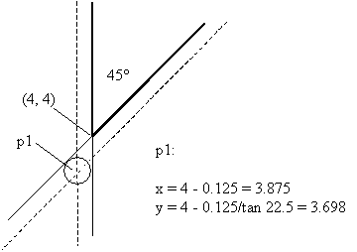
3. Move tool from p0 to p1 in straight line
Linear interpolation
target coordinates
N030 G00 X3.875 Y3.698

Slide 25
4. Cut profile from p1 to p2
Linear interpolation
target coordinates
N040 G01 X3.875 Y9.125
or
N040 G01 Y9.125
X-coordinate does not change ➔ no need to program it

Slide 26
5. Cut profile from p2 to p3
Linear interpolation
target coordinates
N050 G01 X5.634 Y9.125

Slide 27
6. Cut along circle from p3 to p4
circular interpolation, CCW motion
target coordinates
N060 G03 X7.366 Y9.125 I6.5 J9.0
coordinates of center of circle

Slide 28
7. Cut from p4 to p5
Linear interpolation
target coordinates (Y is unchanged)
N070 G01 X9.302

Slide 29
8. Cut from p5 to p1
Linear interpolation
target coordinates (see step 3)
N080 G01 X3.875 Y3.698

Slide 30
9. Return to home position, stop program
Linear interpolation
target coordinates (see step 3)
N090 G01 X2.0 Y2.0 M30
end of data
N100 M00
program stop

Slide 31
Thank you !

